Slide 1

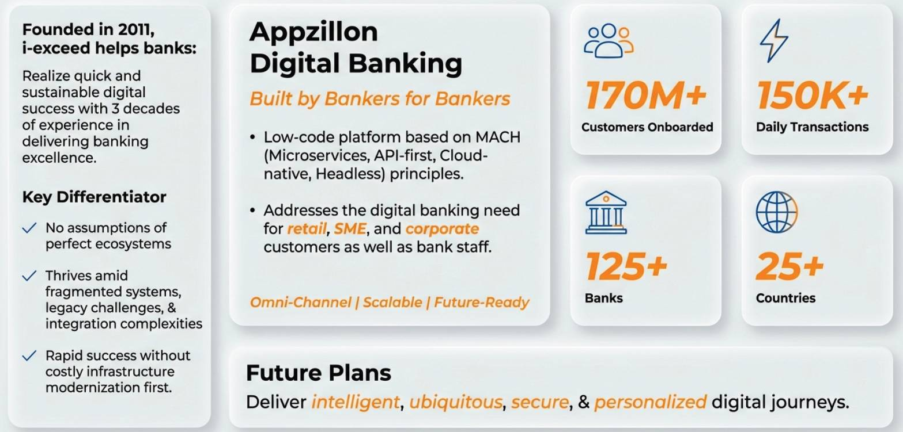
The Power to do More

Slide 2
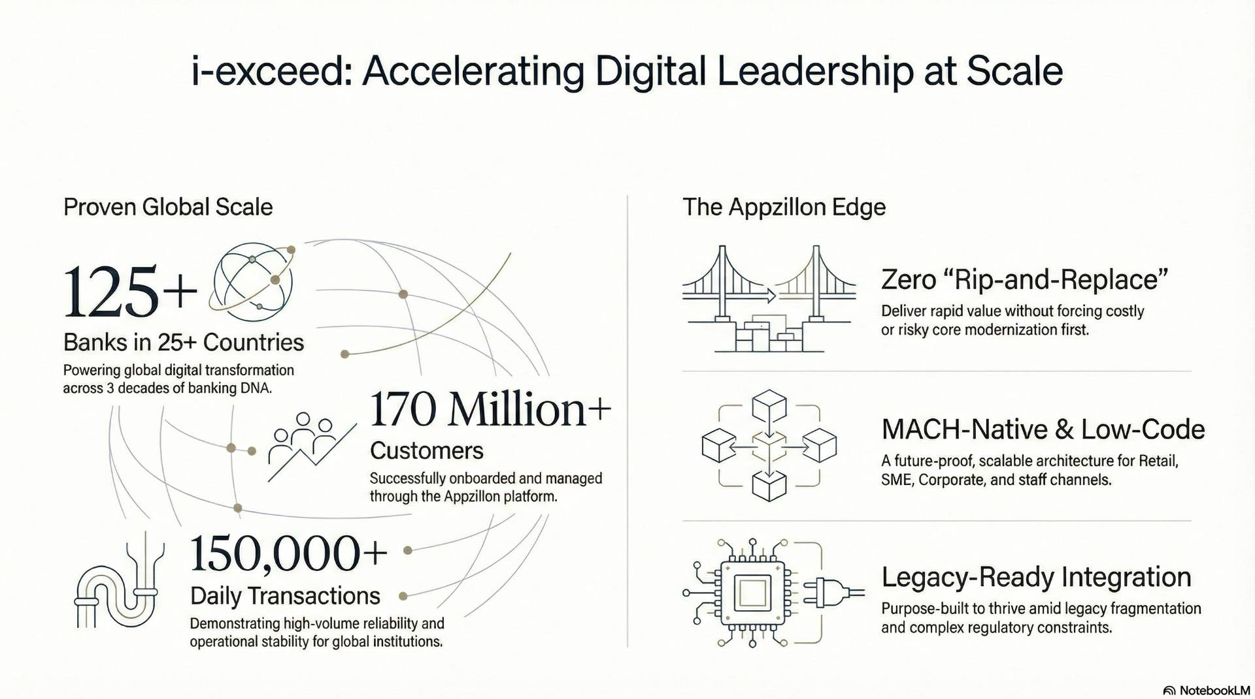

Slide 3
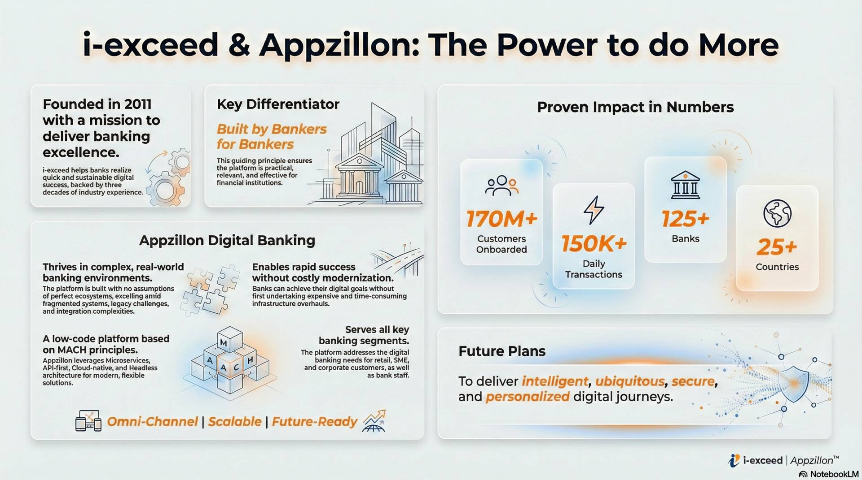
www.i-exceed.com | marketing@i-exceed.com

Slide 4
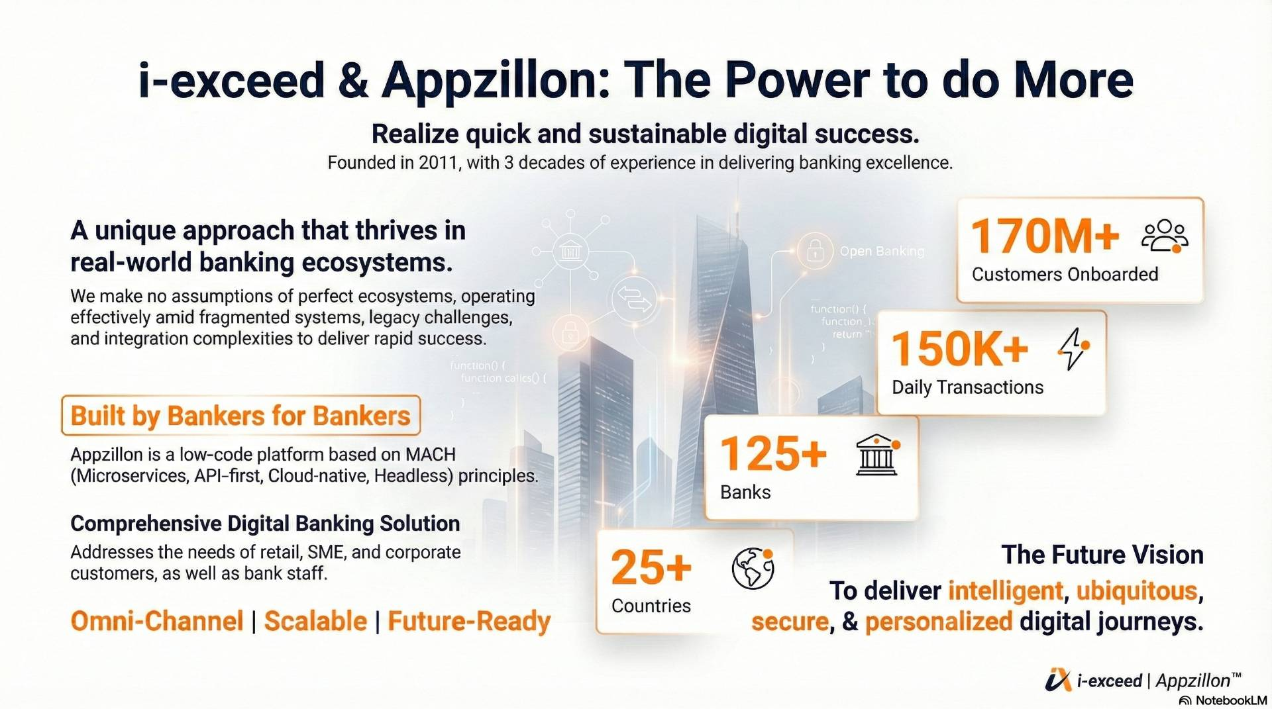
Omni-Channel | Scalable | AI-Ready
Notes:
Remove Apppziilon from heading sustainable digital banking successs remove – founded in 2011 future vision – Reminage

Slide 5
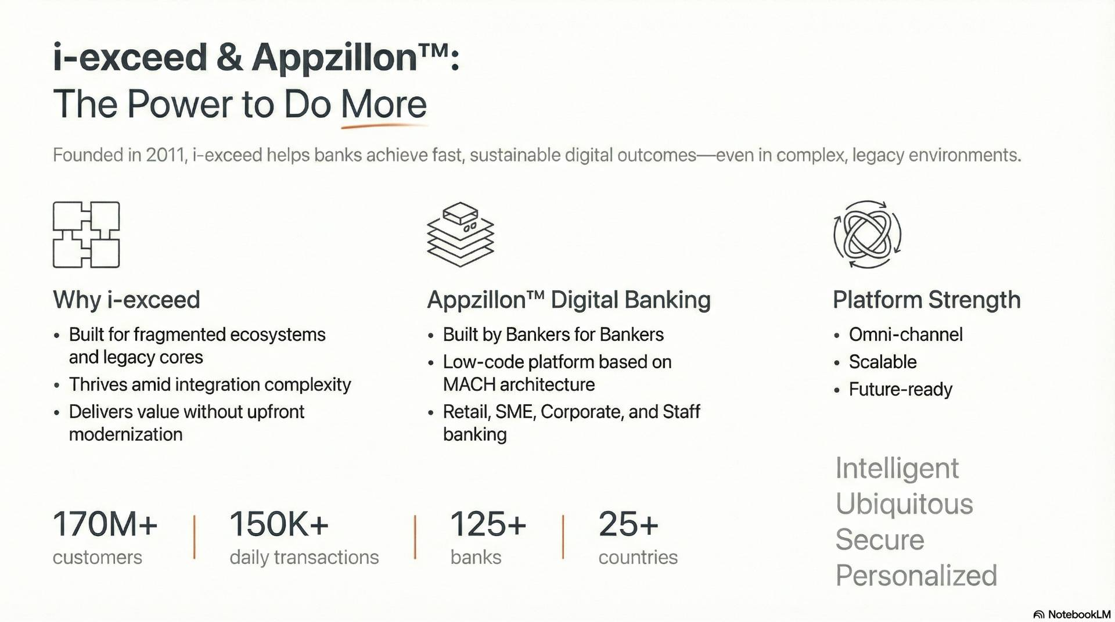
Notes:
Sustainable digital banking outcomes. Why i-exceed World’s leading digital banking specialist built for fragmentd Retail, SME, corporate replace future-ready with AI-ready deliver

Slide 6
