Slide 1

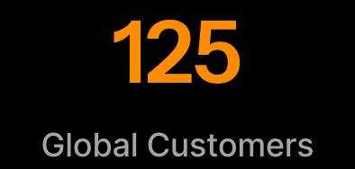

Reimagine Banking Experiences

Slide 2

MACH
Architecture
A modular and cloud-native approach to future-proof innovation
AI-Powered Personalization
Deliver hyper-personalized banking experiences through insights and product recommendations.
We are i-exceed.
Drivers Of The Digital Future Of Banking
Entities and Office Presence in:
USA | UK | UAE | Greece | Singapore | India
Enterprise-Grade Security & Compliance
Multi-layered security framework, regularly audited by Veracode.
True Omnichannel Experience
Provides a seamless user journey across all devices with a single codebase.

Slide 3





Appzillon Digital Banking Suite
Unified | Intelligent | Scalable
Digital Onboarding
Onboard customers and businesses in minutes with instant KYC, KYB, and AML verification. Unified across channels with automated workflows and real-time tracking.
Retail Banking
Deliver end-to-end digital servicing across the customer lifecycle, from transactions to engagement and beyond. Unify banking, payments, and lifestyle services through super apps, digital branches, and ecosystem integrations.
SME / Corporate Banking
Simplify business banking with digital servicing, trade and supply chain finance, cash management, and virtual accounts for greater efficiency and financial control.
Doorstep Banking
Extend banking through distributed agents serving remote and underserved markets, with real-time settlements and built-in compliance for secure, efficient operations.
Lending Solutions
Accelerate lending with fast loan origination, seamless servicing, intelligent collections, and automated processes across the entire lending lifecycle.

Slide 4
Appzillon Digital Banking Platform
Modular | Flexible | Future-Proof
AI-Powered Personalization
MACH
Architecture
Deliver hyper-personalized banking experiences through insights and product recommendations.
A modular and
cloud-native approach to future-proof innovation.
True Omnichannel Experience
Enterprise-Grade Security & Compliance
Provides a seamless user journey across all devices with a single codebase.
Multi-layered security framework, regularly audited by Veracode.

Slide 5



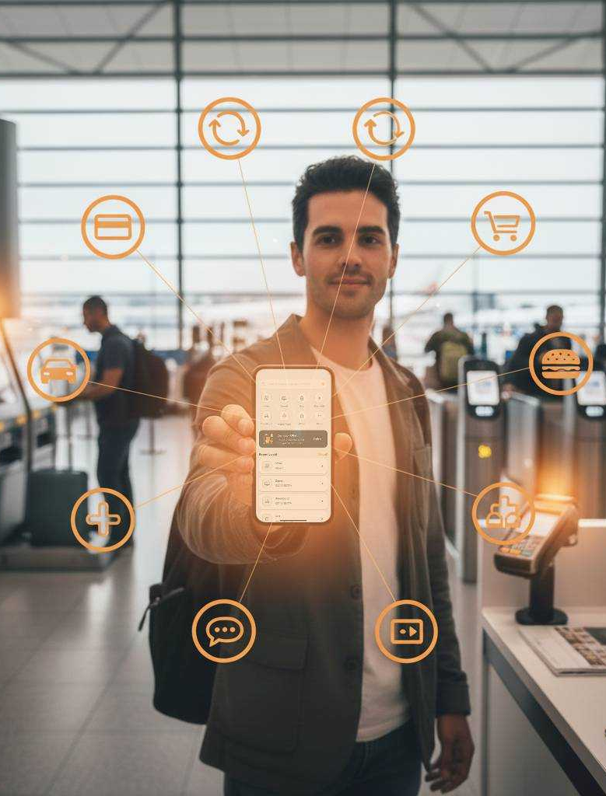


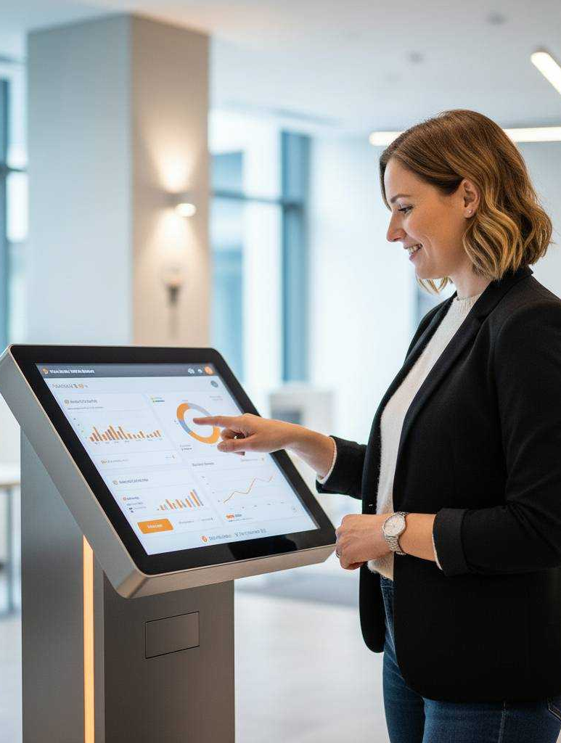

Family Banking
From First Allowance To
Retirement Planning
Superapp
Multiple Journeys For
Lifestyle-driven Banking
Specialized Retail Banking Solutions
Specialized Solutions For Seamless, Secure, Scalable Everyday Banking
PFM
Personalized, Predictive, and Proactive Banking
Financial Inclusion
Reach Every Customer
Digital Branch
Digital-first. Real-world Ready
Credit Unions & Community Banking
Built For Community-driven Banking
Agent Banking
Expand Banking Beyond Branches
Islamic Banking
Purpose-built For Shariah-centered Innovation

Slide 6
Digital Branch
Digital-first. Real-world Ready
Credit Unions & Community Banking
Built For Community-driven Banking
Specialized Retail Banking Solutions
Specialized solutions for seamless, secure, scalable everyday banking
Family Banking
From First Allowance To
Retirement Planning
Superapp
Multiple Journeys For
Lifestyle-driven Banking
Agent Banking
Expand Banking Beyond Branches
Islamic Banking
Purpose-built For Shariah-centered Innovation
PFM
Personalized, Predictive, and Proactive Banking
Financial Inclusion
Reach Every Customer

Slide 7




Supply Chain Finance
Where Liquidity Meets Trust
Cash Management
Optimized Liquidity Control System
Specialized Corporate Banking Solutions
Specialized solutions for precise, scalable enterprise banking
Supply Chain
Finance
Where Liquidity Meets Trust
Cash Management
Optimized Liquidity Control System
Trade Finance
Scales With Your Institution
Virtual Accounts
Efficient Digital Transaction Tracking
Trade Finance
Scales With Your Institution
Virtual Accounts
Efficient Digital Transaction Tracking

Slide 8
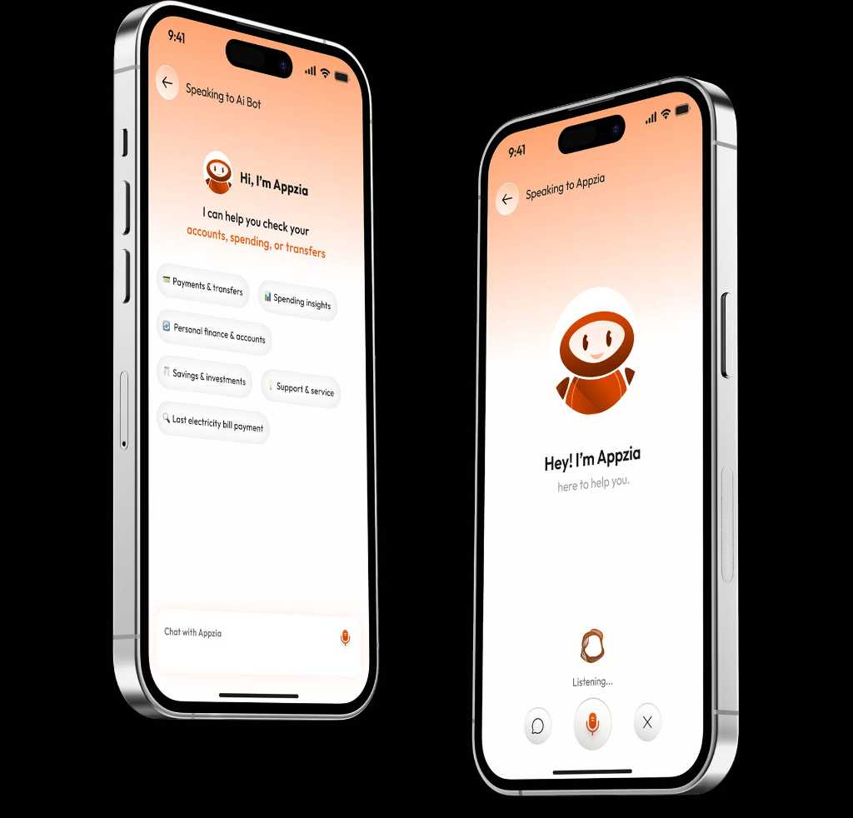
Trade Finance
Scales With Your Institution
Virtual Accounts
Efficient Digital Transaction Tracking
Specialized Corporate Banking Solutions
Specialized solutions for precise, scalable enterprise banking
Supply Chain Finance
Where Liquidity Meets Trust
Cash Management
Optimized Liquidity Control System
Trade Finance
Scales With Your Institution
Virtual Accounts
Efficient Digital Transaction Tracking
Supply Chain
Finance
Where Liquidity Meets Trust
Cash Management
Optimized Liquidity Control System

Slide 9
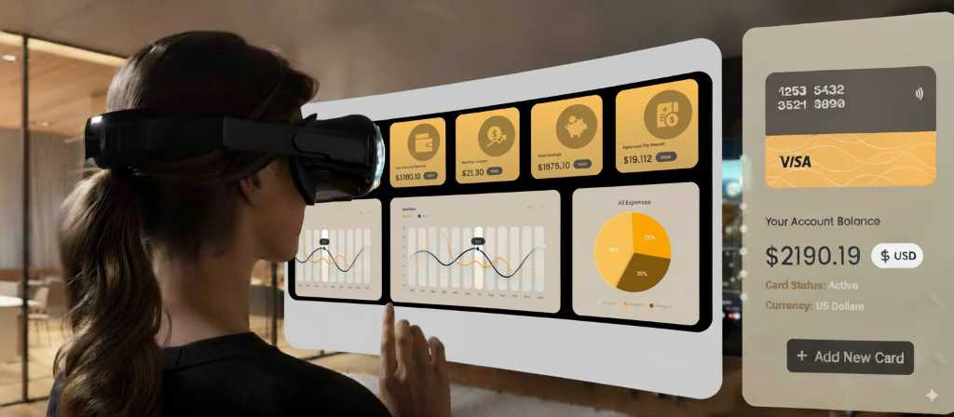
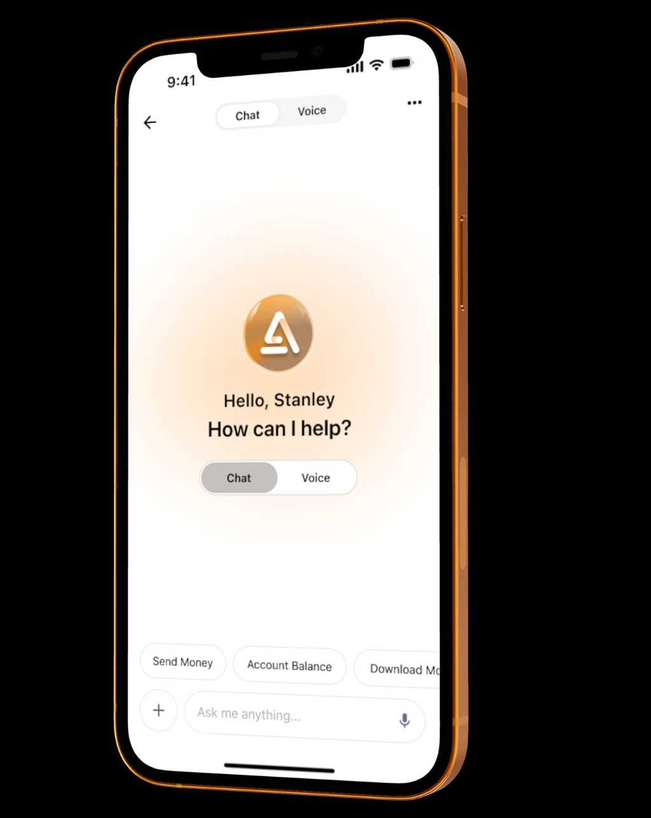
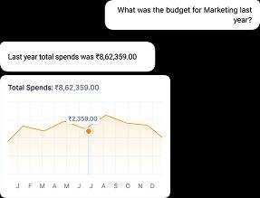

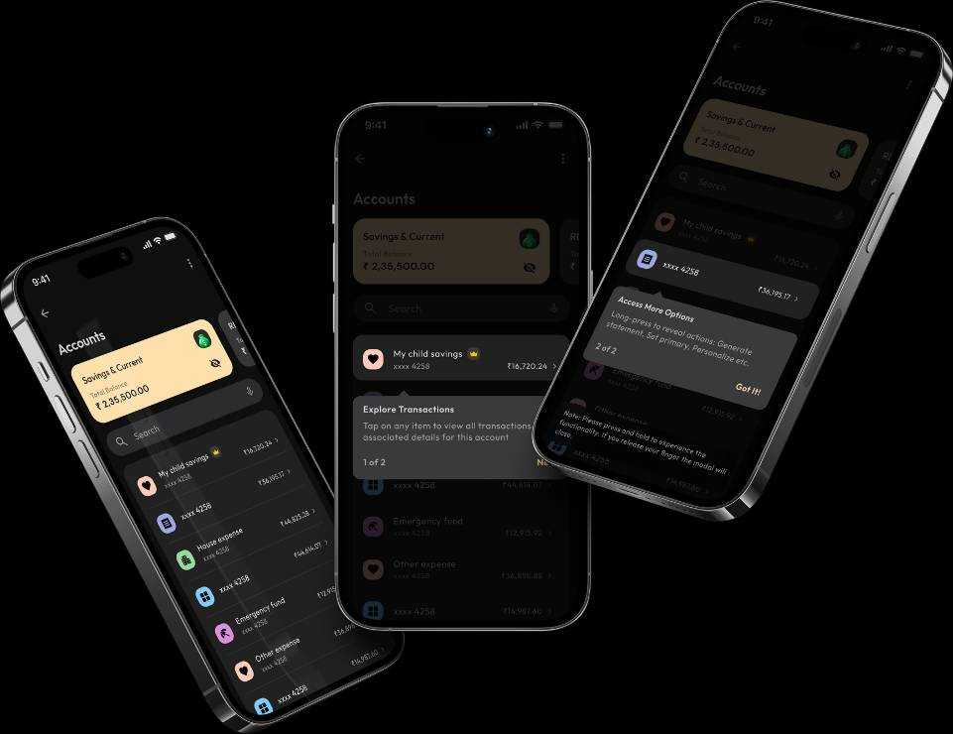

Appzillon X AI
AI-powered Journeys For Elevated Banking Experiences
AI-Driven Advisory & Servicing
Financial Wellness & Security
Conversational AI for Banking
AI for Document Intelligence

Slide 10

Appzillon Labs
Where Financial Experiments Become Market Ready Reality
Generative AI
AI Financial Concierge , Synthetic Data Engine, Process Intelligence
Embedded Finance
API-first Ecosystem Connector, SuperApp Integration Kit, Offer Engine
Metaverse Banking
Virtual Branches Gamified Engagement Hubs

Slide 11



































Our Clients

Slide 12

Thank You
SJR Padukone Towers, 51, 100 Feet Rd, Santhosapuram, Koramangala 2nd Block, Koramangala, Bengaluru, Karnataka 560034
+91 9686095320
saumitra.pandey@i-exceed.com
i-exceed.com/

