Slide 1
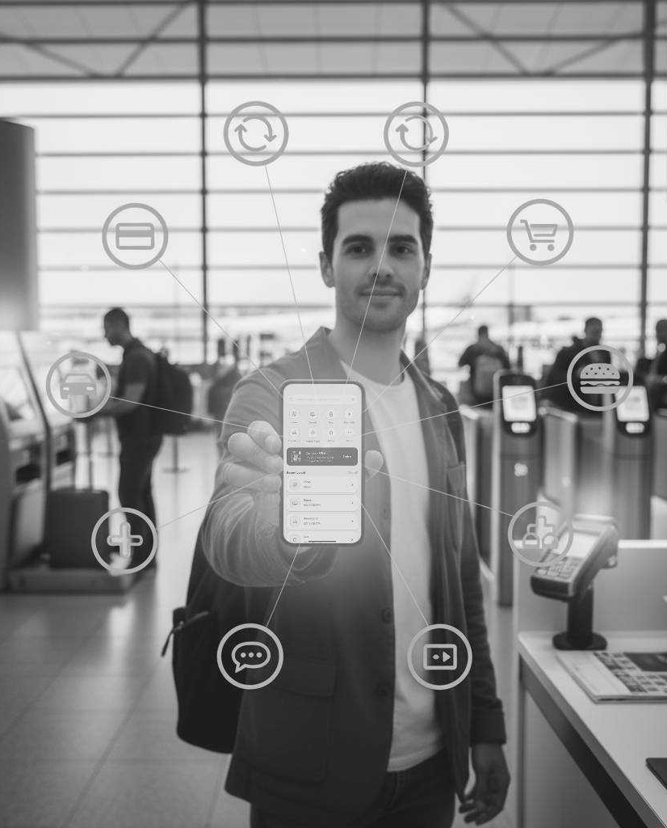
The Future of Banking is Now
Transform Customer Engagement with SuperApp Banking Solutions
Appzillon SuperApp Solutions
Delivering integrated banking experience across every customer touchpoint

Slide 2
The Digital Experience Gap
Why Traditional Approaches Fall Short
Traditional digital strategies are no longer sufficient to meet evolving customer expectations
Customer Experience Crisis
Profitability Squeeze
Generational Divide
As CX declines, customer retention fell from 78% in 2022 to 76% in 2023. Majority of the users expect to accomplish any financial task through mobile, most banks deliver fragmented experiences.
Banks spend up to 70% of IT budgets maintaining legacy systems instead of innovating. Net interest margins narrow while acquisition costs soar- reduced innovation capacity at a critical inflection point..
Gen Z demands instant, personalized experiences embedded in lifestyle apps. Seniors suggest struggle with complex interfaces but control majority banking assets. Single-experience apps alienate both extremes.

Slide 3

The SuperApp Opportunity
01
The SuperApp Movement
Over 50% of the global population will be daily active users of multiple SuperApps by 2027. Customers aren’t looking for better banking apps; they are looking for apps that make banking invisible.
02
Ecosystem Integration Advantage
Over 80% of banking customers prefer digital channels for payment verification and routine transactions. 2025 marks the breakthrough year for conversational banking with AI-powered interfaces.
03
Experience Drives Growth
As CX quality declines, customer loyalty and deposits follow. Banks delivering exceptional digital experiences see measurably higher deposit retention, cross-sell success, and Net Promoter Scores.

Slide 4
The Appzillon Advantage
For Your Customers
For Your Banks
Deep Banking Domain Knowledge
Rapid Deployment
Seamless journeys across mobile, web, wearables, voice with real-time synchronization
Launch new banking products in weeks, not years- respond before competitors
Personalization at Scale
Lower TCO
AI-driven insights that anticipate needs and deliver relevant services at moments of intent
Reduce IT maintenance freeing budget for strategic initiatives
Generationally Adaptive
API-First Architecture
Interfaces that automatically adjust- sophisticated for Gen Z, simplified for seniors
Easy integration with existing systems- no rip-and-replace required
$12T
50%
55%
Gen Z Spending Power
Global SuperApp Users
IT Budget Freed
By 2030- capture it with engaging, lifestyle-integrated banking
By 2027, capture market share with future-ready infrastruture
Optimize IT investment allocation to drive strategic initiatives and revenue growth

Slide 5
Value Delivered
Proven Results Across Global Banking Client Portfolio
Customer Engagement
Operational Excellence
Increased daily active users, improved mobile adoption across all demographics, enhanced cross-sell success through AI-driven recommendations, reduced service call volume
Accelerated time-to-market for new products, reduced total cost of ownership, decreased manual processing, seamless core system integration
Revenue Growth
Risk Mitigation
Deposit growth from enhanced digital experience, increased customer lifetime value, new revenue streams from embedded banking, reduced acquisition costs
Enhanced fraud detection through AI analytics, improved regulatory compliance, future-proofed infrastructure, reduced operational risk

Slide 6
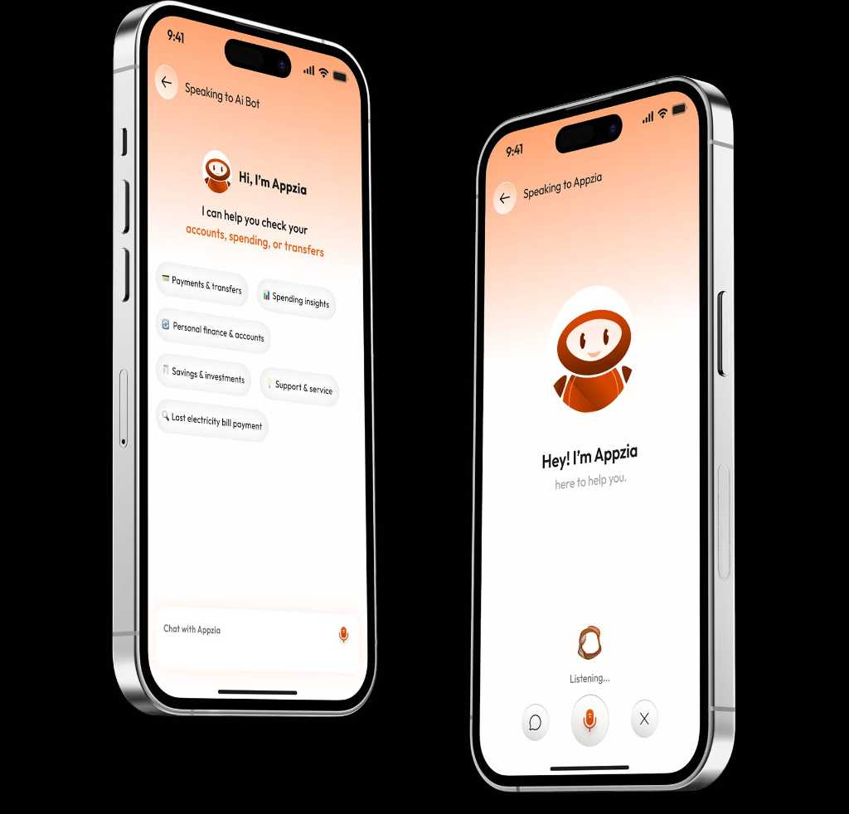
Why i-exceed?
Deep Domain Expertise, Enterprise-Grade Solutions
01
Deep Banking Domain Knowledge
Banking veterans combined with technology innovators who understand both legacy constraints and future possibilities
02
Enterprise-Grade Implementations
Successfully deployed complex platforms for institutions processing millions of daily transactions
03
Research-Backed Strategy
Solutions informed by Gartner, Forrester, Selent insights- ensuring you’re ahead of trends, not chasing them
04
Partnership Approach
We succeed when you succeed- our engagement model aligns incentives with your outcomes

Slide 7
Let’s Build the Future Together
From an app to an ecosystem. From a service to an experience.
Let’s build that future together. Schedule a strategic discovery session or request a customized demo to see Appzillon in action tailored to your priorities.
Write to us at marketing@i-exceed.com
Scan to get in touch with us

