Slide 1
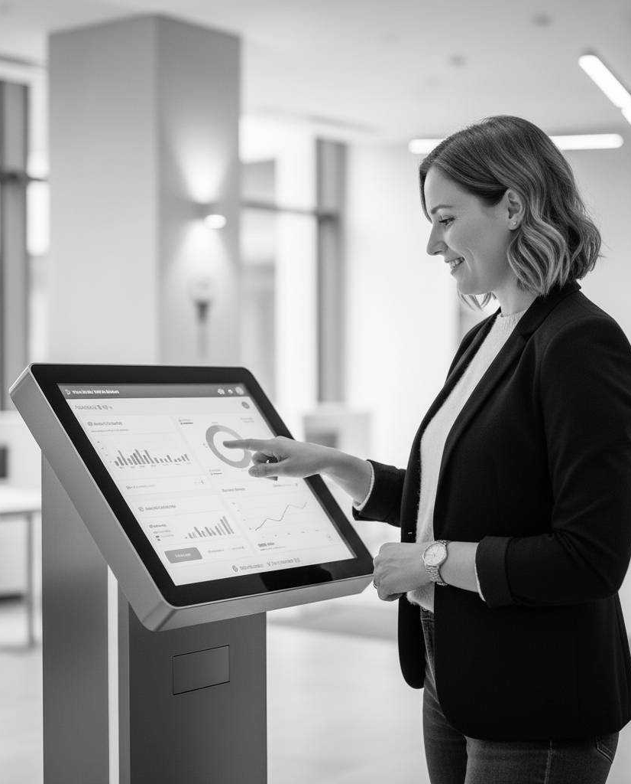
Reimagining Branch Banking for the Digital Age
Shaping the future of branch experiences
Appzillon Digital Branch Solution
###Content needed ###

Slide 2
Challenges in Traditional Branch Banking
65%
70%
Branch Visitors
Routine Tasks
Customers globally still visit branches but expect digital conveniences
In-branch transactions are routine and can be digitized
30%
20%
Productivity Gain
Lower Service Cost
Improvement in staff productivity after adopting digital branches
Banks report lower service cost and significant operational improvements when transitioning into digital branches

Slide 3
Opportunity for Banks
Enhanced Customer Experience
Competitive Advantage
Compliance Burden
Deliver personalized services and seamless interactions across channels, fostering stronger relationships and loyalty
Stay ahead with innovative features and cutting-edge technology in today’s digital-first banking landscape
Streamline processes, reduce turnaround times and improve staff productivity for cost savings

Slide 4
Appzillon Advantage for Banks
01
Omnichannel Platform
04
Microservices Architecture
Seamless integration across mobile, tablet, and kiosk interfaces for unified customer experience
Scalable and resilient system design with inbuilt extensibility for future needs
05
Low-Code Platform
02
Easy Deployment
Empower staff to customize workflows without deep technical expertise required
Quick implementation with minimal disruption to existing banking system and operations
03
AI-Enabled
Smart automation and analytics for improved decision-making and customer insights

Slide 5

Value Delivered
01
Instant Onboarding
Accounts opened in minutes with guided forms and biometric verification for seamless customer experience
02
Self-Service Transactions
Bill payments, transfers, and more independent, instant and fully compliant operations
03
Real-time Service Tracking
Customers see every step, staff act instantly, significantly reducing follow-ups and wait times
04
Operational Insights
Use real-time data to understand peak times, service trends, and customer usage patterns

Slide 6
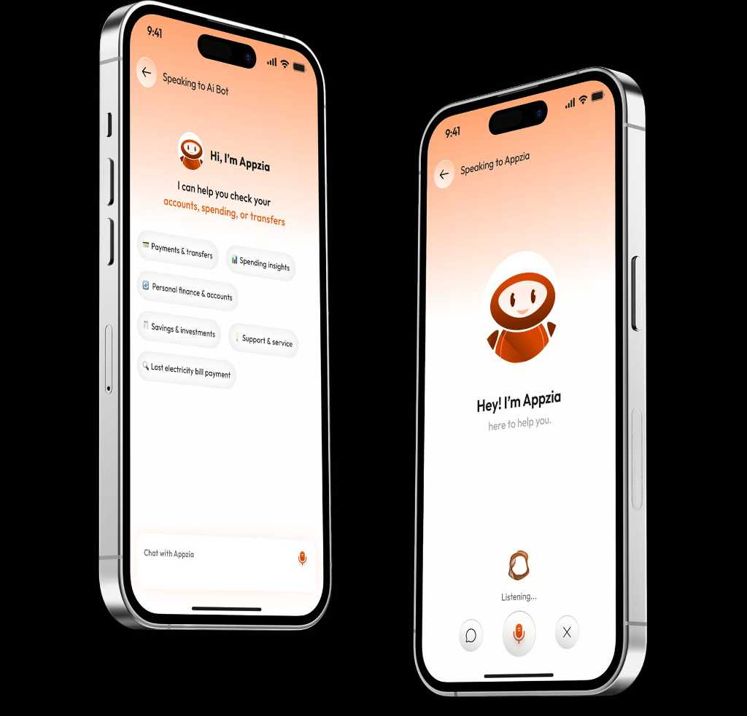
Why i-exceed?
01
Proven Track Record
Trusted by leading financial institutions worldwide with demonstrated success in digital transformation
02
Comprehensive Solutions
End-to-end digital banking suite covering all aspects of modern branch operations and customer needs
03
Customer-centric Approach
Unwavering focus on enhancing customer experience and satisfaction through innovative designs
04
Continuous Innovation
Commitment to evolving with the latest technological advancements and industry best practices

Slide 7
Reimagine Your Branch
Transform your Banking Journey Today
Ready to revolutionize your digital branch banking experience?
Discover how Appzillon can help you deliver exceptional customer service while driving operational excellence
Write to us at marketing@i-exceed.com
Scan to get in touch with us

