Slide 1
Accelerating Onboarding for Efficient Business Growth
Traditional business onboarding hinders growth with cumbersome compliance.
Appzillon Business Onboarding
Empowering banks to deliver streamlined, intelligent and scalable experiences, activating business account activation whilst ensuring robust verification and regulatory adherence.

Slide 2

Business Onboarding Challenges Today
01
Complex Processes
!
Muli-step verifications and paperwork creates delays in account setup
$15.6 Billion
02
Siloed Systems
Disjointed platforms across digital and physical channels duce operational efficiency
!
03
Regulatory Complexity
Evolving KYC, AML and corporate compliance requirements increase workloads
Digital onboarding market opportunity remains untapped
(Source: Global Banking Insights, 2023)
04
Lack of Scalability
Standardized approaches fail to accommodate diverse business needs, leading to dissatisfaction

Slide 3
The Opportunity for Banks
Strategic Partner
Market Leadership
Position as key enablers of business growth with tailored, omnichannel onboarding journeys
Standout with AI-powered insights and real-time compliance checks to drive acquisition
Digital Adoption Rate
Global Business Banking Market
Expected growth in business onboarding solutions by 2030
Annual potential for modernized digital onboarding platforms

Slide 4
Appzillon Advantage for Banks
01
Accelerate Onboarding
Reduce setup time from weeks to hours with guided digital workflows and KYC validation
02
Streamline Operations
Orchestrate approvals dynamically based on business size, industry and regulatory needs
03
Strengthen Security
Automate fraud detection and identity verification without compromising user experience
Omnichannel access across web, mobile, and branches with configurable insights and full visibility

Slide 5
Use Cases in Action
Embedded Intelligence
Smart Guidance
Scalable Integration
Real-time risk assessment and business profiling with prioritized alerts
Automated support ensures compliance whilst adapting to global and local standards
Unified channels eliminate manual interventions, empowering teams with live tracking

Slide 6
Reimagine Cash and Liquidity Management
01
Accelerate Growth
Transform weeks into hours with intelligent automation
02
Embed Smart Compliance
Built-in adaptability to every regulatory requirements
03
Deliver Trust and Insight
Full transparency across business onboarding journeys

Slide 7
Value Delivered Across Stakeholders
55%
70%
65%
Cost Reduction
Faster Activation
Fewer Delays
In operational overhead and processing time
Improvement in account setup speed
Reduction in onboarding related bottlenecks

Slide 8
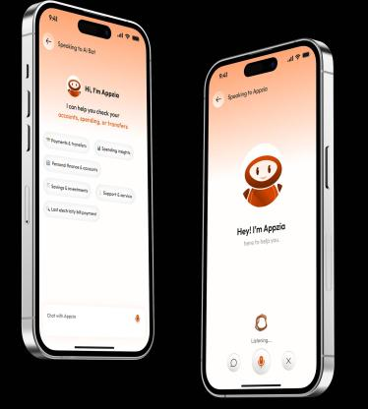
Why i-exceed?
01
50M+ Daily Transactions
Seamlessly processing millions of transactions daily for enhanced efficiency and speed across global markets
02
125+ Bank Partners
Trusted by leading financial institutions across APAC, Middle East and beyond now expanded globally with proven expertise
03
25+ Countries Served
Our solutions empower financial institutions and their clients across diverse global markets with localized expertise

Slide 9
Ready to Transform Business Onboarding?
Partner with Appzillon to modernize your Business onboarding operations
Join leading banks worldwide in delivering faster, smarter and more efficient experiences. Schedule a strategic discovery session or request a customized demo to see Appzillon in action tailored to your priorities.
Write to us at marketing@i-exceed.com
Scan to get in touch with us

