Slide 1

Reimagining Corporate Banking
Solve today’s operational drag, win tomorrow’s corporate clients
Appzillon Corporate Banking
Turn legacy complexity into advantage- with fewer risks and faster outcomes

Slide 2
The Concrete Problems Slowing Growth
21%
30%
CX Score Decline
Digital Success Rate
Brands globally saw customer experience scores decline
Only 30% of banks report success in fully achieving digital transformation objectives
01
Legacy Cores
02
Data Silos
03
Compliance Overheads
Slow reconciliations and manual fixes add days to client cycles and shrink margins
Limited cross-product views prevent timely credit decisions and increase operational errors
Rule changes and audit demands absorb scarce risk-management bandwidth
04
Client Expectations
05
Process Gaps
Corporates demand cash-flow visibility and integrated payments, or they move to alternatives.
Tech alone won’t work if staff lack role-specific AI tools and clear workflows

Slide 3
Where Digital Investment Pays
79%
31%
60%
Global Banking
Revenue Lift
AI Adoption
Digital technology is unlocking financial inclusion
Digital & AI initiatives deliver expected revenue lift on average
Corporate banks in Southeast Asia report conversational AI adoption
Multi-trillion Market
Shifting Expectations
AI in Production
Corporate/Trade Finance market valued at $9.7 Trillion (GM Insights 2024) – a large addressable base for modern services
Banks that modernize CX are positioned to keep strategic corporate relationships with humanized, connected experiences
Early adopters are already running ”digital workers” in middle/back offices, replacing repetitive work and improving decision speed

Slide 4

Purpose-Built to Close the Gap
01
Legacy → Seamless Integration
Adapters and API that keep running while you modernize (no big-bang ripouts)
02
Silos → Unified Customer 360
A single, auditable source for cash, trade, and lending views to shorten credit cycles
03
Manual → Automated Controls
Configurable rules, AI-assisted checking and workflow playbooks that shrink exceptions and audit effort
04
Workforce Uplift
We remove integration pain, automate routine risk controls and surface the data that lines up with commercial decisions
Role-specific tools and embedded guided workflows to raise productivity without headcount spikes

Slide 5


Outcomes that Matter to CFOs, COOs and Heads of FIs
Fewer Manual FTE Hours
Per 10k transactions, dramatically reducing operational costs
Lower Exception Rates
Automated controls minimize manual interventions and operational risks
Improved Client NPS
Enhanced customer experience drives loyalty and retention
Reduced Time-to-Onboard
Incremental Fee Revenue
Streamlined processes accelerate client acquisition and revenue generation
Real-time services unlock new monetization opportunities

Slide 6
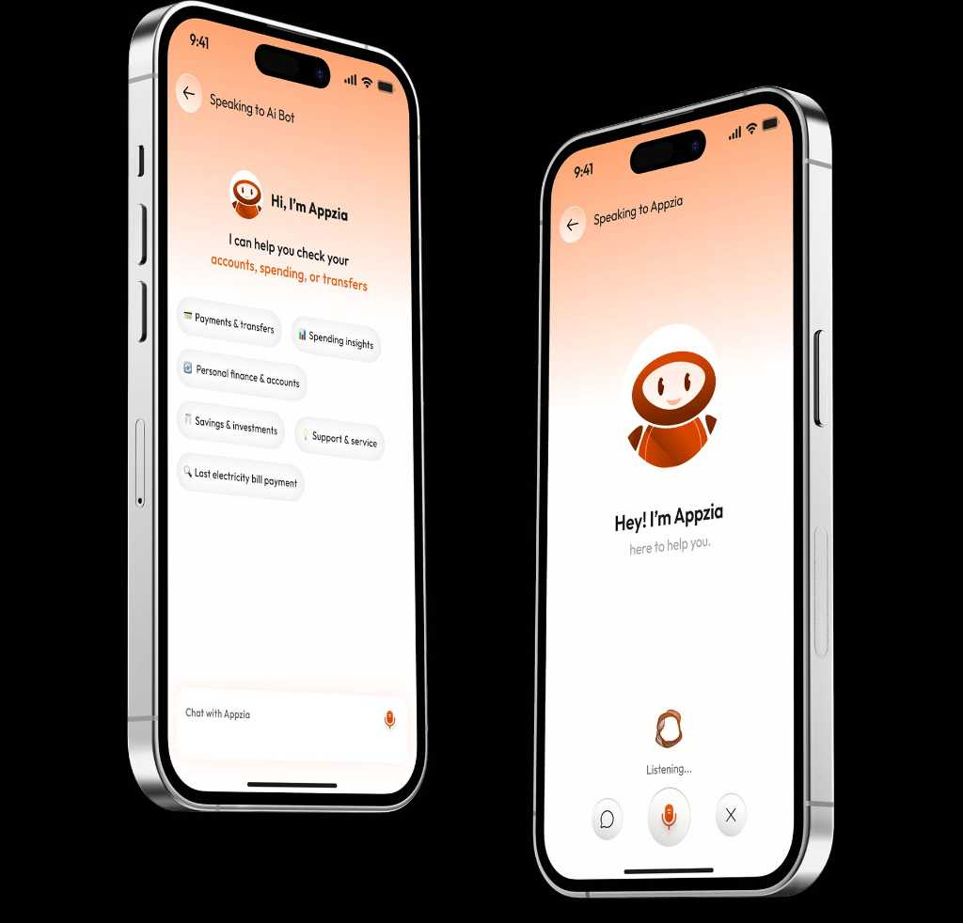
Practical, Proven, Repeatable
01
Multiple Enterprise Deployment
Successful implementations across the world demonstrate proven scalability and reliability
02
Industry Recognition
Acknowledged expertise in enterprise banking solutions and digital transformation
03
Measurable Improvement
Case studies showing quantifiable operational enhancements and ROI delivery
We are i-exceed
Trusted by leading financial institutions worldwide for
mission-critical banking transformation

Slide 7
Prove. Scale. Sustain.
Transform your Banking Journey Today
Demonstrate measurable value through targeted pilot implementations, expand successful solutions across your organization systematically and build lasting competitive advantage through continuous improvement.
Ready to transform your corporate banking operations?
Write to us at marketing@i-exceed.com
Scan to get in touch with us

