Slide 1

Mastering Cash and Liquidity Management for Financial Control
Traditional cash systems lack real-time insight and efficiency.
Appzillon Cash & Liquidity Management
Empowering banks to deliver proactive, data-driven solutions, enhancing liquidity optimization and financial oversight for businesses

Slide 2

Cash and Liquidity Management Challenges Today
!
01
Limited Visibility
Delayed insights into cash positions hinder decision-making and strategic planning
Manual Processes
£9.8 Billion
02
Labor-intensive reconciliations increase operational risks and reduce efficiency
!
03
Inadequate Forecasting
Static models fail to predict cash flow trends accurately in dynamic markets
Market opportunity for advanced cash management solutions remains untapped
(Source: Financial Analytics Report, 2023)
04
Fragmented Systems
Disconnected platforms reduce agility in liquidity management operations

Slide 3
The Opportunity for Banks
Trusted Financial Partner
Competitive Advantage
Position as strategic advisors for with real-time liquidity insights and proactive guidance to clients
Differentiate through predictive analytics and automated cash flow optimization capabilities
68%
Digital Adoption Rate
£14.5T
Market Growth
Expected growth in cash management solutions by 2030
Expected growth in cash management solutions by 2030

Slide 4

Appzillon Advantage for Banks
01
Enhance Visibility
Provide real-time cash position tracking and consolidated liquidity views across all accounts
02
Streamline Operations
Automate reconciliations and cash flow forecasting with AI-driven insights and analytics
03
Optimize Liquidity
Enable proactive adjustments with predictive analytics and comprehensive scenario planning
Cash Management that Adapts Dynamically
Omnichannel access across web, mobile, and ERP integrations with configurable dashboards and complete transparency

Slide 5
Use Cases in Action
Scalable Integration
Embedded Intelligence
Real-time cash monitoring with prioritized alerts for liquidity risks and opportunities
Embedded Intelligence
Smart Forecasting
Smart Forecasting
Connected Monitoring
Predictive Connectivity
Automated predictions adapt to market trends and business cycles for accurate planning
Seamless Cashflow
Real-time Insights
Scalable Integration
Unified channels eliminate manual interventions, empowering teams with live data access

Slide 6

Reimagine Cash and Liquidity Management
01
Boost Efficiency
Transform manual processes into automated, real-time workflows that eliminate bottlenecks and human error
02
Embed Predictive Insights
Built-in analytics that adapt to every cash flow scenario, providing forward-looking intelligence
03
Deliver Control and Clarity
Full transparency across liquidity management journeys with comprehensive reporting and visibility

Slide 7
Value Delivered Across Stakeholders
For Banks
For Businesses
For Finance Teams
Improved Efficiency, reduced risks, and enhanced client satisfaction through superior service delivery
Greater control over cash positions with faster access to comprehensive liquidity solutions
Streamlined processes with actionable insights delivered in real-time for strategic decisions.
60%
75%
70%
Cost Reduction
Better Forecasting
Fewer Risks
In operational overhead and processing time
Improvement in cash flow prediction accuracy
Reduction in liquidity-related issues

Slide 8
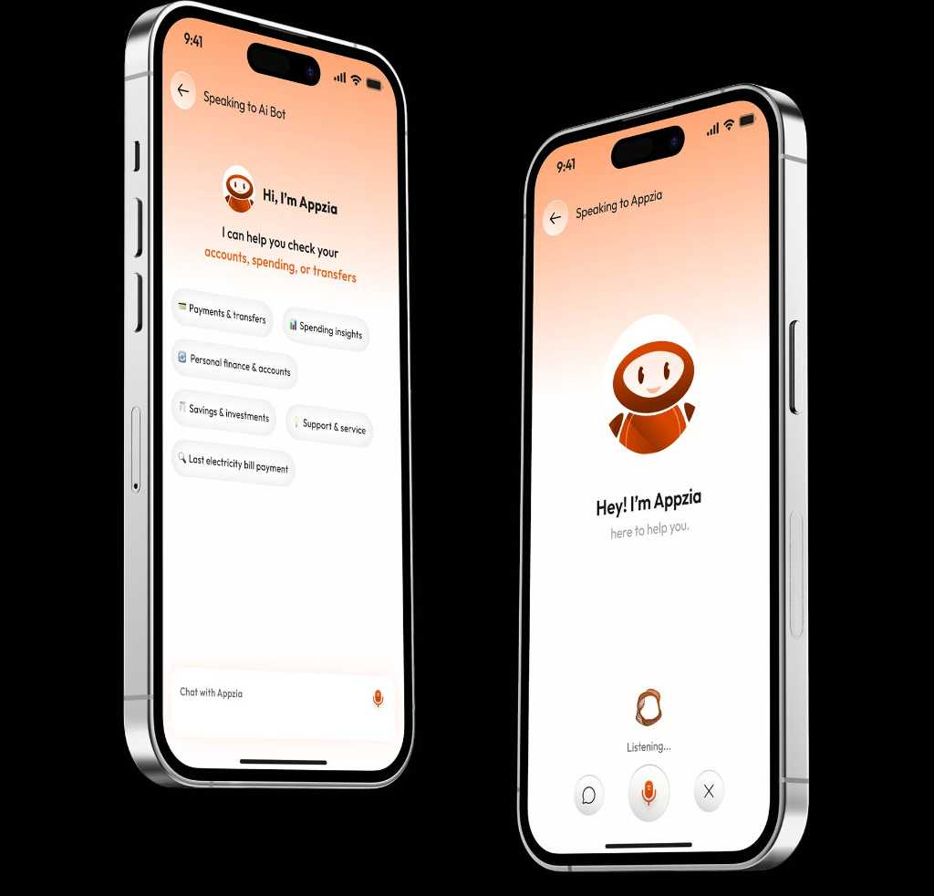
Why i-exceed?
01
50M+ Daily Transactions
Seamlessly managing millions of transactions daily for peak efficiency across all platforms
02
125+ Bank Partners
Trusted by leading financial institutions across APAC, Middle East and Globally
03
25+ Countries Served
Our solutions empower financial institutions worldwide with proven results

Slide 9
Ready to Transform Cash and Liquidity Management?
Partner with Appzillon to modernize your cash and liquidity management operations
Join leading banks worldwide in delivering smarter, more efficient financial solutions that drive growth and client satisfaction. Schedule a strategic discovery session or request a customized demo to see Appzillon in action tailored to your priorities.
Write to us at marketing@i-exceed.com
Scan to get in touch with us

