Slide 1

Redefining Personal Finance Management
Traditional PFM Tools Are Impersonal, Opaque And Lacks Proactivity
Appzillon PFM Solution
Transform traditional financial management into personalized, predictive and proactive growth engines that empower banks to deliver exceptional customer service

Slide 2

PFM Challenges Today
01
Complex Processes
!
Muli-step verifications and paperwork creates delays in account setup
$1.2 Trillion
02
Siloed Systems
Disjointed platforms across digital and physical channels duce operational efficiency
!
03
Regulatory Complexity
Evolving KYC, AML and corporate compliance requirements increase workloads
Potential market for personalized financial solutions remains untapped
(Global Financial Insight)
04
Lack of Scalability
Standardized approaches fail to accommodate diverse business needs, leading to dissatisfaction

Slide 3
The Opportunity for Banks
Trusted Advisor
Competitive Edge
Market Leadership
Position as trusted advisors offering personalized financial journeys
Differentiate with predictive analytics and real-time guidance
Capture growing demand for intelligent financial solutions
$6.8T
65%
Digital Adoption Rate
Global Market
Expected growth in PFM solutions by 2027
Annual opportunity for modernized PFM platforms

Slide 4

Appzillon Advantage for Banks
01
Accelerate Personalization
Deliver tailored advice with AI-driven insights and real-time data integration across all touchpoints
02
Streamline Insights
Orchestrate financial planning dynamically based on spending patterns, goals and behavioral analytics
03
Enhance Proactivity
Automate predictive cash flow alerts and recommendations without disrupting user experience
Appzillon PFM Adapts to Every Customer
Omnichannel access across web, mobile, and branches with configurable insights and full visibility

Slide 5
Use Cases in Action
Embedded Predictive Intelligence
Smart Guidance
Scalable Engagement
Providing real-time cash flow forecasts with severity-based alert prioritization and intelligent risk assessment
Automated advice ensure proactive planning. Adapting to global and personal financial trends seamlessly
Unified channels eliminate manual follow-ups while empowering advisors with real-time tracking capabilities

Slide 6

Reimagine PFM
01
Accelerate Personalization
Transform months into days with intelligent automation and advanced analytic capabilities
02
Embed Smart Insights
Built-in intelligence that adapts to every financial goals and customer lifecycle stage
03
Deliver Trust and Visibility
Complete transparency across every personal finance journeys with real-time tracking and reporting

Slide 7
Value Delivered Across Stakeholders
For Banks
For Individuals
Faster personalization, smarter insights , and reduced friction across workflows and operations
Trust and confidence through seamless, real-time financial support and personalized guidance
80%
90%
85%
Faster Processing
Fewer Planning Issues
Faster Advice

Slide 8
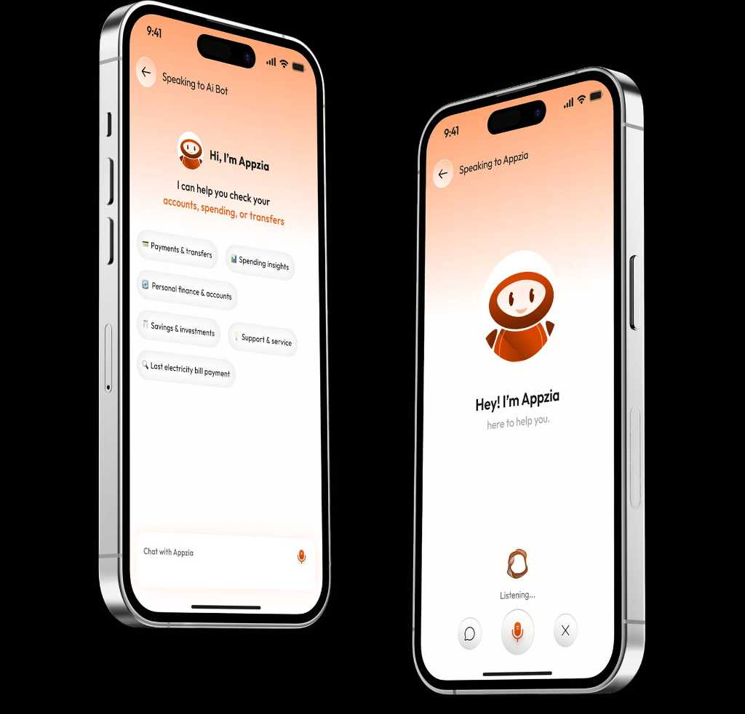
Why i-exceed?
01
50M+ Daily Transactions
Seamlessly processing millions of transactions daily for enhanced efficiency and speed across global markets
02
125+ Bank Partners
Trusted by leading financial institutions across APAC, Middle East and beyond now expanded globally with proven expertise
03
25+ Countries Served
Our solutions empower financial institutions and their clients across diverse global markets with localized expertise

Slide 9
Ready to Transform PFM?
Partner with Appzillon to modernize your personal finance management operations
Join leading banks worldwide in delivering faster, smarter and more trusted financial solutions. Schedule a strategic discovery session or request a customized demo to see Appzillon in action tailored to your priorities.
Write to us at marketing@i-exceed.com
Scan to get in touch with us

