Slide 1

Reimaging Digital Banking with i-exceed
Delivering Intelligent, Intuitive, and Impactful Experiences

Slide 2

Company Overview
Our Mission
Transform banking experiences through innovative digital platforms that empower financial institutions to deliver seamless, personalized services at scale
125+
25+
13+
150M+
Banks
Countries
Years of Experience
Customers
Trusted partnerships across retail, corporate, and community banking sectors
Global presence spanning North America, Europe, Asia-Pacific, and emerging markets
Over a decade of expertise in digital banking innovation and implementation
Empowered by Appzillon’s Low-Code and AI-Powered Solutions

Slide 3
Market Landscape: Digital Banking Evolution
Key Trends Shaping the Industry
Embedded Finance
AI-Powered Experience
Low-Code Platform
Banking integrated into non-financial platforms
$138B revenue potential by 2030
Predictive analytics & automation
20–30% better fraud detection
Rapid app development
70% faster time-to-market
Challenges
Learnings
Legacy system modernization
Cybersecurity & compliance complexity
Customer experience differentiation
Competitive fintech disruption
Open banking API monetization
Real-time payment infrastructure
Hyper-personalized services
Global digital expansion

Slide 4

Appzillon Solutions Overview
01
Infrastructure Layer
Cloud-native with enterprise security, scalability and compliance built in. Supports hybrid and multi-cloud deployments
Identity Layer
Universal ID
Paperless verification
Secure document storage
02
Banking Modules
Core banking integration, payment processing, account management, and transaction engines. Pre-built APIs and microservices to connect with core systems accelerate implementation
Payments Layer
Real-time transactions
Low-cost, inclusive payments
Embedded finance solutions
Data Layer
Secure data exchange
User-driven access controls
Cross-sector financial insights
03
Digital Experience Layer
Low-code development environment enabling rapid creation of personalized journeys. Unified data layer ensures consistent experiences across all touchpoints.
Services Layer
Personalized solutions
Cross-platform accessibility
Expanded reach globally
04
Channel Delivery
Omnichannel deployment across mobile, web, voice, wearables and emerging interfaces. Single codebase powers all channels with device-optimized experience

Slide 5
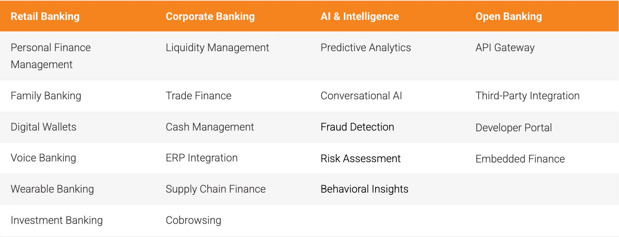
Appzillon Solution Map
Comprehensive capabilities spanning retail, corporate, AI-driven intelligence and open banking ecosystems

Slide 6
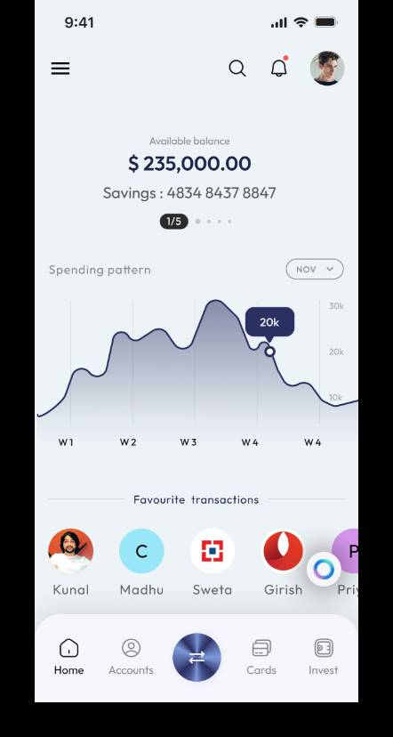
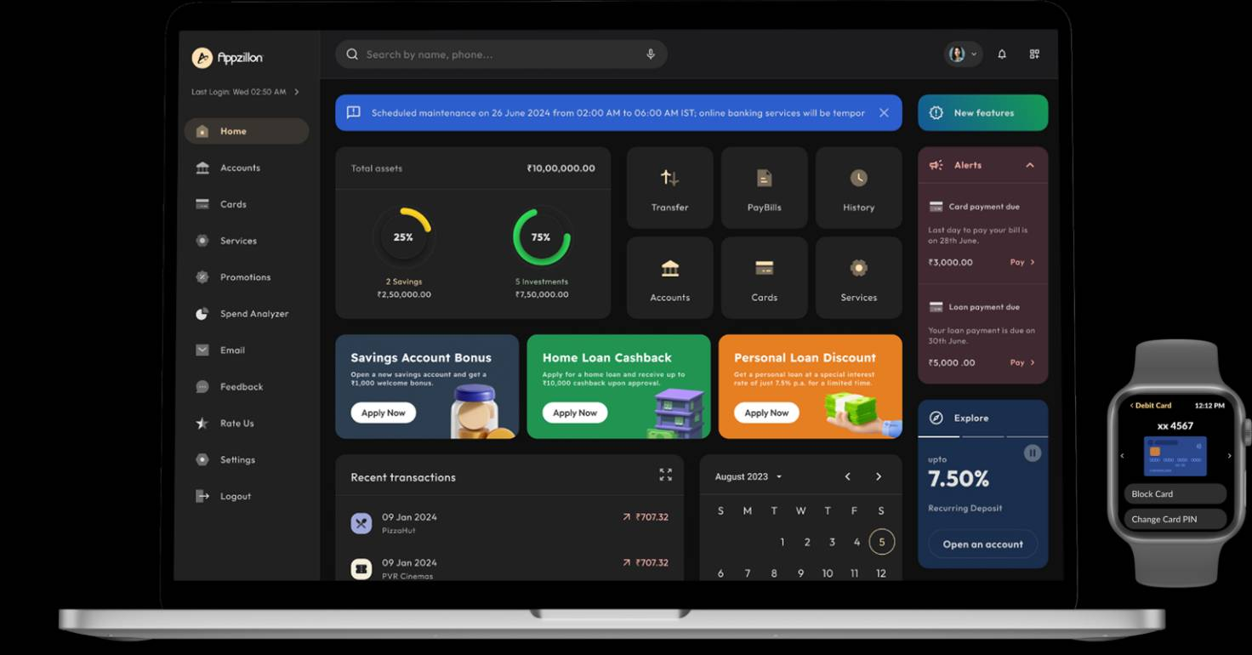
Retail Banking Solutions
Personal Finance Management
Family Banking
Predictive Banking
Voice Banking
Wearable Integration
Digital Wallets
Investment Banking

Slide 7
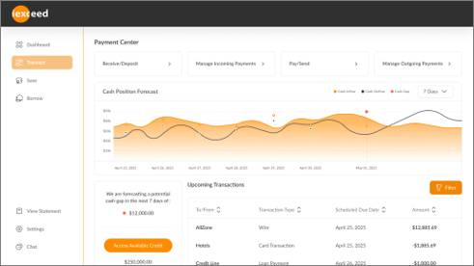
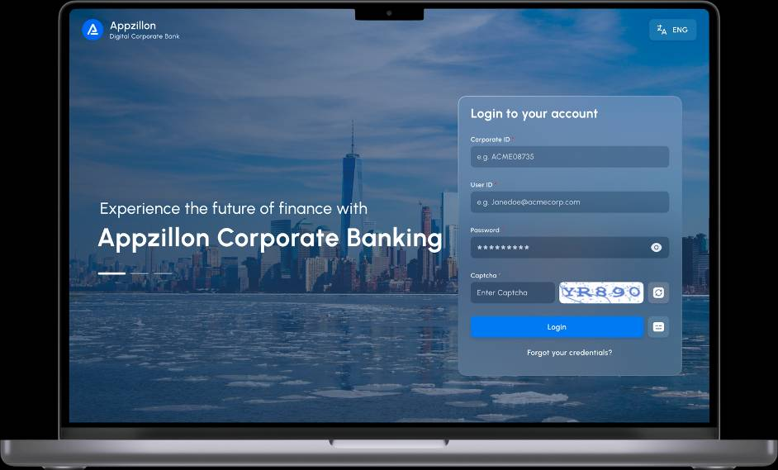
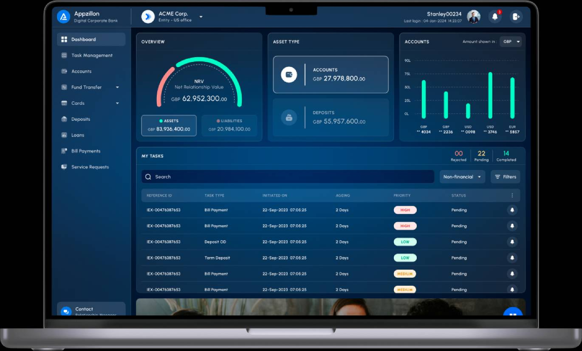
Corporate / Business Banking Solutions
Liquidity Management
Trade Finance
ERP Integration
Virtual Assistance & Cobrowsing
Treasury Operation
Cash Management
Foreign Exchange (FX) Services
Commercial Lending
Working Capital Management
Risk Management Solutions
Payment Solutions
Supply Chain Finance

Slide 8
Near-touch Business Banking with Appzillon AI Native
01
Appzillon Agentic AI
Composable with RLHF, seamlessly integrated into workflow
02
Appzillon AI for Servicing
Personalized insights and predictive, smart-advisor-driven banking
03
Appzillon AI for Onboarding
KYC, ID verification, multilingual support, plus real-time document analysis
04
Curated Appzillon RAG LLMs
Ingest documents, retrieve context, ensure auditability
05
Appzillon AI for Support & Backoffice
Cross-system reconciliation, issue escalation, and dynamic reporting
06
Appzillon AI for Risk, Fraud & Security
Anomaly detection, high-risk profiling and early warnings

Slide 9
Embedded Finance & Open Banking Ecosystem
Banking Marketplace
Open API Architecture
Embedded Finance Solutions
Comprehensive digital marketplace offering loans, investments, insurance and wealth management products from multiple providers through a unified platform.
RESTful APIs enable secure third-party integrations, fostering innovation and creating new revenue streams through strategic partnerships
White-label banking capabilities integrated seamlessly into e-commerce fintech, and enterprise platforms, enabling non-banks to offer financial services

Slide 10
Complete Customer Lifecycle Journey
End-to-end digital banking experience designed to maximize customer value and lifetime enagement
Engagement
Advisory
Retention
Personalized dashboards, financial insights, proactive alerts
AI-driven recommendations, wealth management, goal planning
Cross-sell opportunities, premium services, ecosystem partnerships
Onboarding
Transactions
Retention
AI-powered KYC, instant account creation, digital documentation
Real-time payments, multi-currency support, instant settlements
Loyalty programs, rewards optimization, relationship management

Slide 11
Platform Differentiators
01
Accelerate Onboarding
Reduce setup time from weeks to hours with guided digital workflows and KYC validation
02
Streamline Operations
Orchestrate approvals dynamically based on business size, industry and regulatory needs
03
Strengthen Security
Automate fraud detection and identity verification without compromising user experience

Slide 12






Industry Recognition & Proven Success
Analyst Recognition
IDC MarketScape
Forrester Wave
Celent Model Bank
Leader in Core Banking Modernization 2024
Strong Performer in Digital Banking Platforms
Excellence in Innovation & Customer Experience
Customer Success stories
Digital transformation serving 95M+ customers across 10,000+ branches with enhanced operational efficiency and customer satisfaction
Rapid deployment of trade finance platform processing $2B+ in transactions with 60% faster turnaround times
Banking the unbanked with 100M+ accounts leveraging postal network reach and mobile-first technology

Slide 13
Product & Solutions Roadmap: FY 2025 & 2026
Strategic feature releases aligned with market demands and emerging technology trends
Q1 & Q2 2025
Q3 & Q4 2025
Q1 & Q2 2026
Q3 & Q4 2026
Virtual Accounts
Chatbots (Retail & Corporate)
Credit Code Optimization & Synchronization
Analytics- Customer App
PFM
Family Banking
Marketplace Banking
Predictive Banking
Intelligent Advisors
Flutter- Cross-Platform Development
AI for Fraud Detection & Security
AI for Onboarding
Security & Audit Microservice
Cobrowsing (Corporate)
Investment Banking
Trade Finance
Supply Chain Finance
Liquidity Management
Embedded Finance
Multi-language Voice Banking

Slide 14
Vision 2026 & Beyond
Next-generation capabilities positioning i-exceed at the forefront of banking innovation
01
Agentic AI Banking
Fully autonomous AI agents managing complex banking operations, from loan origination to portfolio management, with minimal human intervention.​
02
Predictive Banking Intelligence
Advanced analytics predicting customer needs, market trends, and risk factors before they materialize, enabling proactive decision-making.
03
Cross-Platform Orchestration
Unified banking experience across mobile, web, voice, AR/VR, and emerging interfaces with seamless context switching.​
04
Bank-in-a-box Evolution
Complete digital bank deployment in under30 days with pre-configured compliance, licensing support, and go-to-market playbooks for global markets.​
05
Blockchain & DeFi Integration
Native support for digital assets, tokenization, smart contracts, and decentralized finance protocols within traditional banking frameworks.​

Slide 15
The i-exceed Advantage
Scalable Architecture
Enterprise Security
Cloud-native microservices platform handles millions of transactions daily with auto-scaling capabilities and99.99% uptime SLA.​
Bank-grade security with SOC 2, PCI-DSS, ISO 27001 compliance, zero-trust architecture, and continuous threat monitoring.​
Global Reach
Future-Ready Innovation
Multi-region deployment, multi-currency support, localized compliance, and 24/7 global support infrastructure.​
Continuous R&D investment ensuring platform evolution with emerging technologies including AI, quantum computing, and Web3.​

Slide 16
Competitive Differentiation
i-exceed delivers unmatched ROI through comprehensive digital banking solutions that drive revenue growth, operational efficiency, and exceptional customer experiences.​
300M+
40%
60%
Faster Time-to-Market
Operational Cost Reduced
Customers Served
Compared to traditional core banking implementations​
Through automation and intelligent processing​
Across retail, corporate, and government sectors globally​

Slide 17
Transform your banking operations with us
i-exceed’s future-ready platform is built for what’s next.
Across 50+ markets and 300M+ customers, i-exceed stands as a trusted partner in digital transformation. With a platform that’s secure, flexible, and relentlessly supported, we help banks reimagine what’s possible—today and tomorrow.
Schedule an analyst briefing or Write to us at
marketing@i-exceed.com
Scan to get in touch with us

